Slide 1
Cell Phone Detector

Slide 2
Introduction
Cell phone detectors are devices designed to identify and track cell phone signals.
The pocket-sized cell phone detector can detect the hidden active cell phone. So, this project is used to neglect the use of cell phones in exam halls, private rooms, defense establishments, hospitals, military camps, petrol pumps. They are also very useful for sensing the use of cell phones for spying and other correlated activities. This circuit can detect calls, SMS, video transmission even when the cell phone is hidden in silent mode. The prompt bug detects radio frequency transmission signal (RF) from a cell phone, it generates a beep sound alarm.

Slide 3
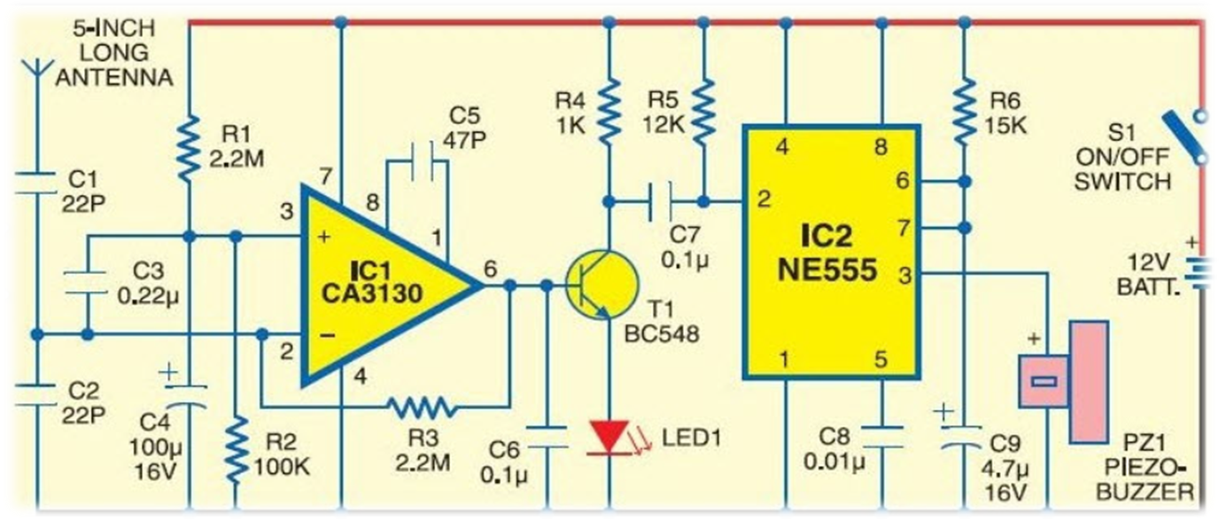
Block Diagram
The block diagram illustrates the main components of a cell phone detector:
1. Antenna
2. Signal Amplifier
3. Frequency Mixer
4. Filter
5. Detector/Processor
6. Indicator/Alarm
7. Power Supply

Slide 4
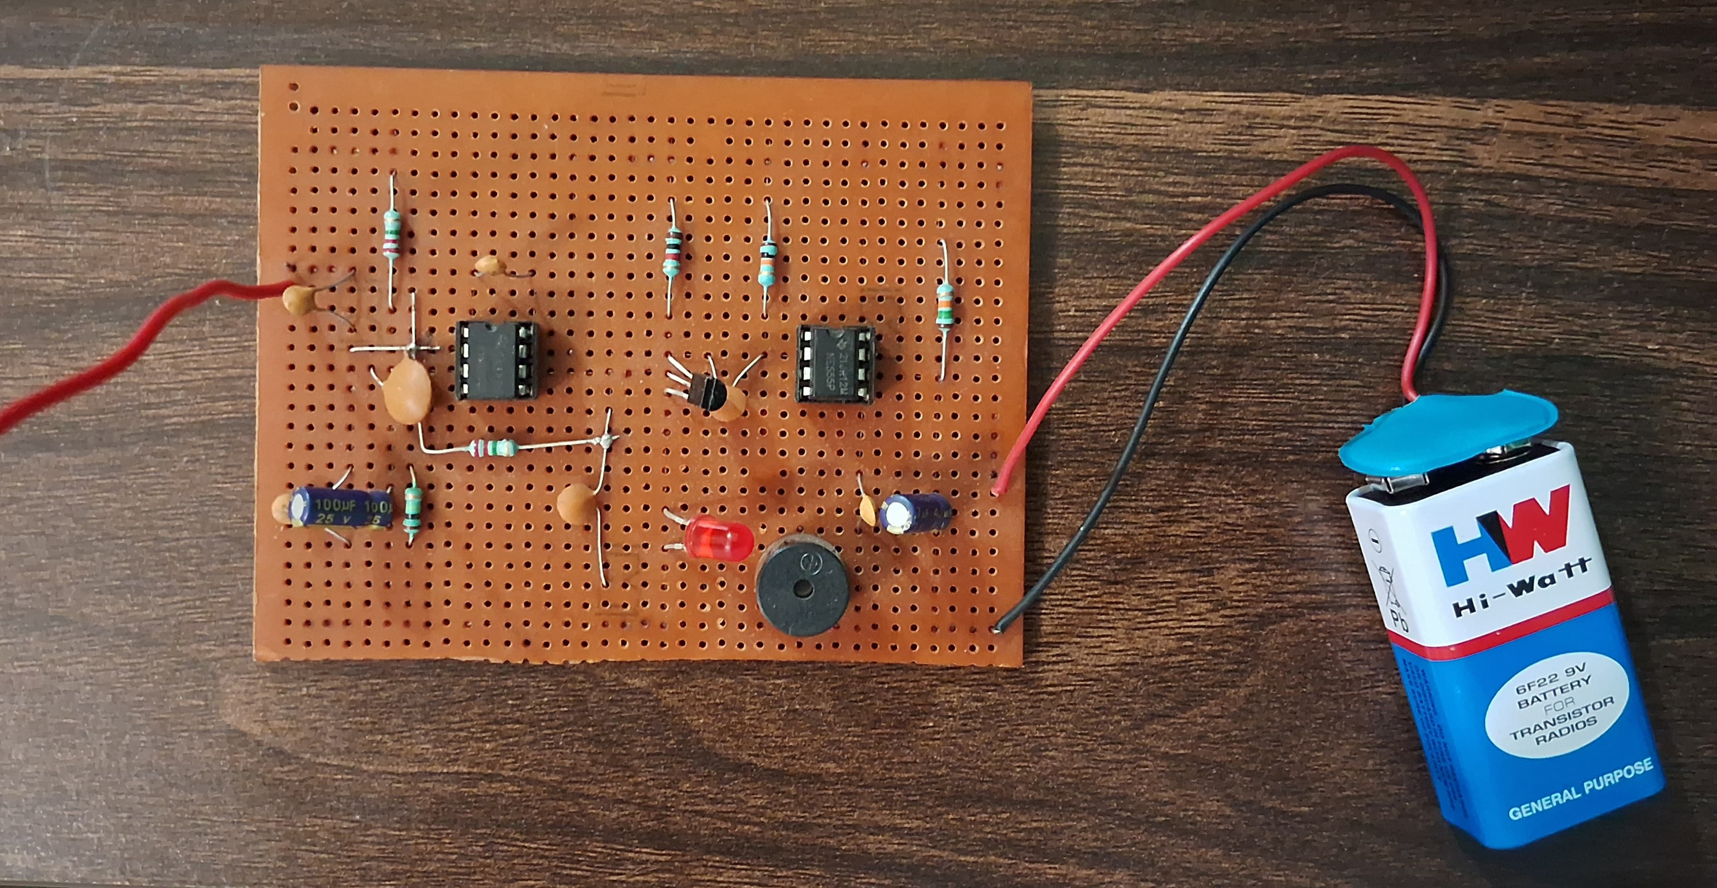
Circuit Diagram
The circuit diagram depicts the interconnections between the components, including the antenna, signal amplifier, mixer, filter, detector, indicator, and power supply.

Slide 5
Working Principles
1. The antenna captures cell phone signals.
2. The signal amplifier boosts the signal strength.
3. The frequency mixer combines signals for processing.
4. The filter isolates specific frequency bands.
5. The detector identifies cell phone transmissions.
6. The indicator or alarm notifies the user.
7. The power supply ensures the device's operation.

Slide 6
Working
The transmission frequency of cell phones ranges from 0.9Hz -3GHz with a 3.3cm -10cm wavelength. RF signals can be collected from the cell phone along with the disk capacitor and the leads which act as a small gigahertz loop antenna. When the cell phone is triggered, it transfers the signal in a sine waveform which permits through space. The circuit diagram of the hidden active cell phone detector is built with an operational amplifier, monostable multivibrator, and piezo buzzer.

Slide 7
Applications
Cell phone detectors find applications in various sectors:
- Security Checks
- Exam Halls
- Prisons and Law Enforcement
- Corporate Security
- Theaters and Performances
- Healthcare Facilities

Slide 8
Conclusion
In conclusion, cell phone detectors play a crucial role in ensuring security, integrity, and privacy in various environments. Their applications span from secure facilities to public spaces, contributing to a controlled and secure communication environment.
Made by
Ishom Sharma-121071
Abhigyan Varma-121079
Aadarsh -121055

Slide 9
References
ChatGPT
https://www.slideshare.net/MoinAman/project-report-of-cell-phone-detector-circuit
https://www.elcircuit.com/2012/06/cell-phone-detector-circuit-diagram.html

